Slide 1
Deep Learning for Natural Language Processing (NLP)
Week 11, Day 2

Slide 2
Limitations of Bag-of-Word Method
In the previous lecture, we learned how to create a bag-of-words (BOW) model to create an intuitive understanding of the source text dataset. However, as we saw, the BOW model ignores location information of the word. Hence, "today it will rain" and "will it rain today" will have the same BOW vector repesentations.
Additionally, we lose the semantic meaning of words and their usage in sentences. For example, "cars" and "automobiles" could be represented as two different models, such that "used cars for sale" and "purchase old automobiles" could create totally different vector representations, although they are quite similar in our human understanding. Finally, BOW models fail to understand, and often ignores, rarely used new words added to the vocabulary.

Slide 3
Deep NLP Models
So far, we were interested in processing the textual data we have and building models which mainly utilized the frequency of each word in a sentence to make decisions. However, using deep learning algorithms, we can learn interdependencies between words in a sentence, irrespective of the position of words, and the length of the sentences.
As we saw yesterday, some of the state-of-the-art NLP methods are able to translate between languages, summarize articles, predict the sentiment of tweets and social media posts, and more. In this exercise, we will learn to build a text sentiment classifier to classify movie reviews as either positive or negative.
We will code everything in Tensorflow and will learn new concepts as we go! We will use a dataset named IMDB Reviews, which is available here: http://ai.stanford.edu/~amaas/data/sentiment/

Slide 4
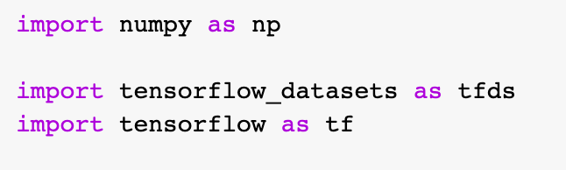
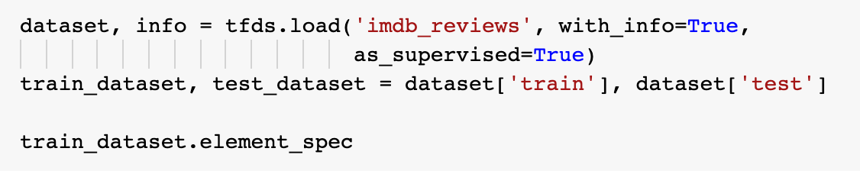
Input Pipeline for Deep NLP Projects
We will use tensorflow dataset package tfds to import the IMDB movie review dataset. We will then extract the train and test splits of the dataset to two variables named train_dataset and test_dataset.

Slide 5
Input Pipeline for Deep NLP Projects
We need to then create a text encoder to encode the raw text in a format which the deep learning model understands. This can be done using the TextVectorization function available in Tensorflow. If we look at the API documentation, we can see that:
> This layer has basic options for managing text in a Keras model. It transforms a batch of strings (one example = one string) into either a list of token indices (one example = 1D tensor of integer token indices) or a dense representation (one example = 1D tensor of float values representing data about the example's tokens). If desired, the user can call this layer's adapt() method on a dataset.
> When this layer is adapted, it will analyze the dataset, determine the frequency of individual string values, and create a 'vocabulary' from them. This vocabulary can have unlimited size or be capped, depending on the configuration options for this layer; if there are more unique values in the input than the maximum vocabulary size, the most frequent terms will be used to create the vocabulary.
https://www.tensorflow.org/api_docs/python/tf/keras/layers/TextVectorization

Slide 6
Input Pipeline for Deep NLP Projects
The processing of each example contains the following steps:
1. Standardize each example (Default: lowercasing + punctuation stripping)
2. Split each example into substrings (Default: whitespace, usually words)
3. Recombine substrings into tokens (usually ngrams)
4. Index tokens (Default: int, associate a unique int value with each token)
5. Transform each example using this index, either into a vector of ints or a dense float vector.
Yes it was a little low budget, but this movie shows love!
yes it was a little low budget but this movie shows love
Standardization refers to preprocessing the text, typically to remove punctuation or HTML elements to simplify the dataset.
Tokenization refers to splitting strings into tokens (for example, splitting a sentence into individual words by splitting on whitespace).
Vectorization refers to converting tokens into numbers so they can be fed into a neural network.
https://www.tensorflow.org/api_docs/python/tf/keras/layers/TextVectorization

Slide 7
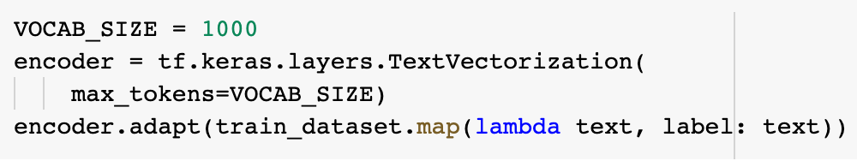

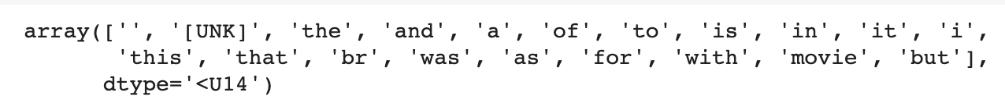
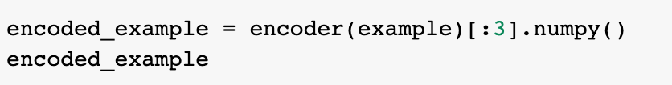
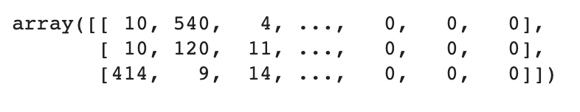
Input Pipeline for Deep NLP Projects
Vocabulary
Encoded sentence
https://www.tensorflow.org/api_docs/python/tf/keras/layers/TextVectorization

Slide 8
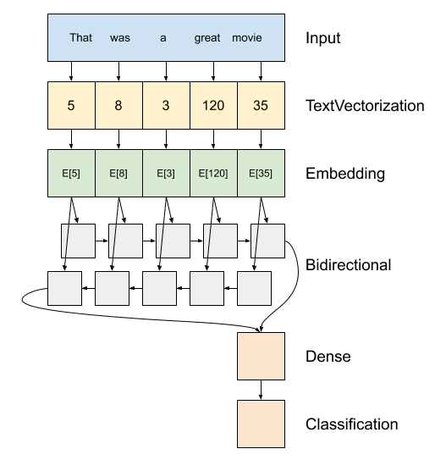
Deep NLP Model
Once we have the vectorized form of our input text from the text encoder, we can pass that to a deep learning algorithm to learn to map the input text indices of the sentences to an output label. Here, the labels will be binary (either positive or negative review).
We have an embedding layer after the text encoder. It stores one trainable embedding-vector per word. When we pass a text indices vector of a sentence as input, the embedding layer converts the sequence of word indices and return a vector for corresponding to each index. During training, words with similar meanings will form similar embedding vectors.
Once the embedding vectors are generated, they are passed to a bi-directional recurrent neural network (RNN) layer. We are not going to discuss the inner working of RNNs in this lecture, but let us take a look at a high-level summary.

Slide 9

Recurrent Neural Networks - Intuition
Whenever there is a sequence of events, it is often advantageous to learn to map the sequences towards the final prediction. For example, in a sentence, the sequence of words have a lexical flow with nouns, verbs, adverbs, adjectives, and other elements carefully sequenced together.
A RNN layer propagates the input forward through it across different time steps. That is, the different layers in the RNN are responsible to enforce temporal dependencies of the input and output. The inner working of an RNN can be understood by studying the simple diagram below. Imagine what we would have done if we had to create an FCN algorithm to process text. We would simply convert the sentences into embeddings and fed them to a stack of Dense layers. In RNNs though, we would rely on the inner states to pass inputs word by word, and change the parameters of the RNN such that the sequence of information impacts the final result.
Unrolled RNN
Wonder
W
O
N
R

Slide 10
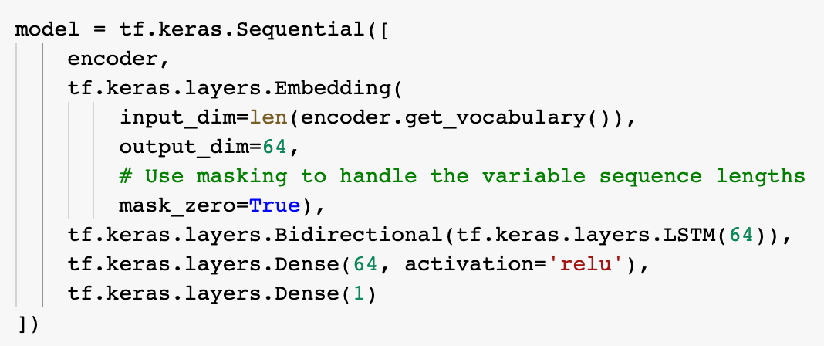
Deep NLP Model
The output of the Bidirectional RNN is passed to a Dense layer with 64 nodes, and then further passed to the output layer for final binary classification.

Slide 11
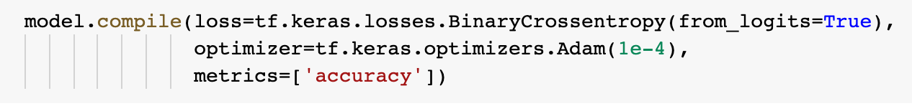
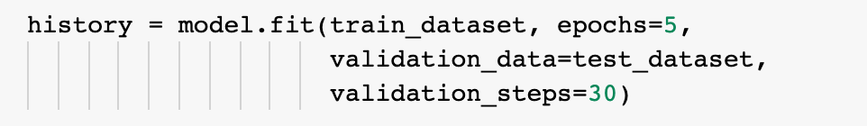
Training the model
Once we have defined the model, now we can compile the model with the loss and optimizer functions just like we did for the DNN and CNN examples last week. We can then fit the model on the train dataset to train the embedding layer, RNN, and dense layers. Note that the RNN layer has multiple layers inside which enables the temporal or sequential nature of learning. The overall parameters of the model is thus dependent on the embedding size, number and size of RNN layers, and the number and size of dense layers.

Slide 12
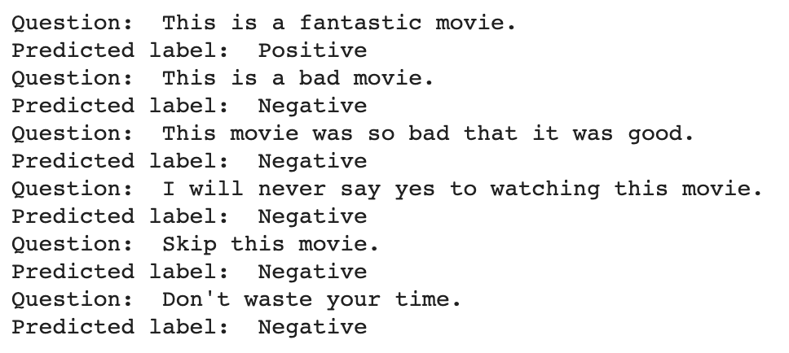
Evaluating the performance
We can run evaluate method on the model to find the test loss and accuracy.
Now, given a new input, we can understand if a movie review is positive or negative.
We can now experiment by adding multiple RNN layers to the network and trying out different types of RNN layers.

